Slide 1
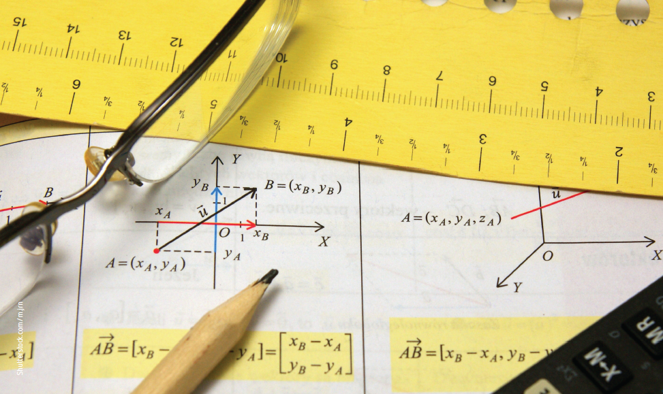
Chapter 1: Gravity and motion
Notes:
Image description: Graphs and charts of vectors (vector) theory together with glasses, calculator and wood pencil

Slide 2
Stimulus question
How is it possible to add two quantities together when they have different magnitudes and point in different directions?
Notes:
Teaching activity:
Before beginning the chapter, divide the students into small groups and ask them to answer the question to the best of their ability.
After completing the chapter, read through the stimulus question with the students. As a class answer the question.
Ask the students to review their answer that they wrote before completing the chapter to their final answer.

Slide 3
1.1 Vector and directional analysis
Key terms
parallelogram method | component | resolute | rectangular components | scalar multiplier
Notes:
Teaching activity:
Each of the key terms for 1.1 is listed in the table above.
Ask the students to copy the table and complete a definition for each term.

Slide 4
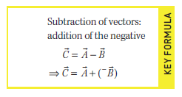
Key formula
Notes:
Teaching activity:
Read and discuss the key formula

Slide 5
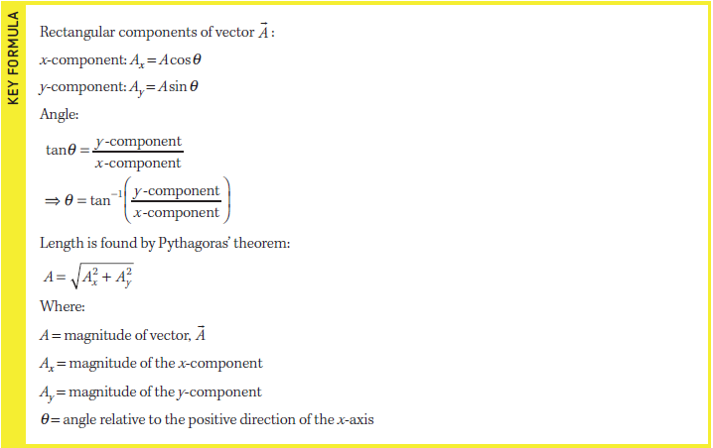
Key formula
Notes:
Teaching activity:
Read and discuss the key formula

Slide 6
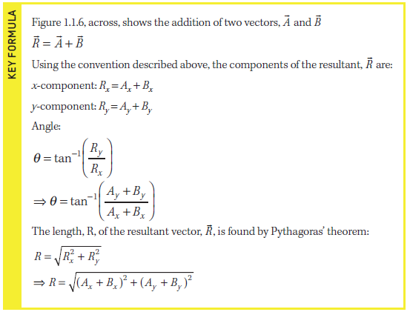
Key formula
Notes:
Teaching activity:
Read and discuss the key formula

Slide 7
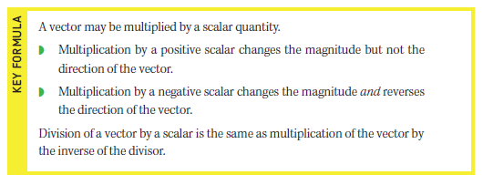
Key formula
Notes:
Teaching activity:
Read and discuss the key formula

Slide 8
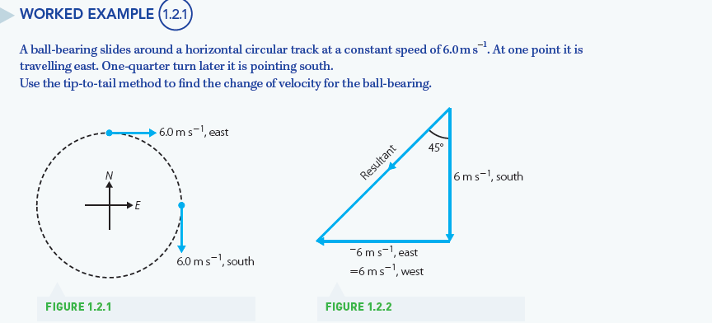
Worked example 1.2.1
Notes:
Teaching activity:
As a class, work through the example provided

Slide 9
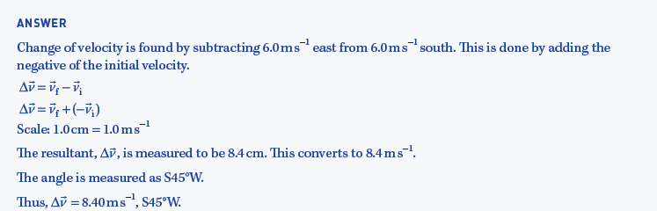
Worked example 1.2.1 (cont’d)
Notes:
Teaching activity:
As a class, work through the example provided

Slide 10
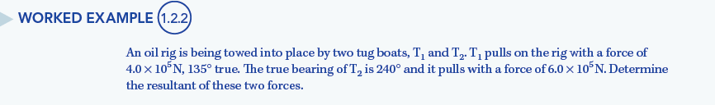
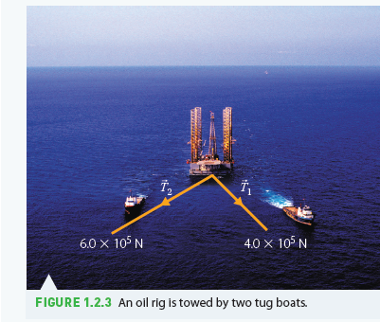
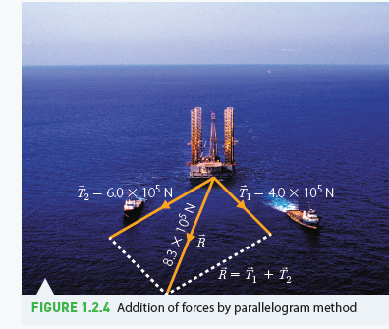
Worked example 1.2.2
Notes:
Teaching activity:
As a class, work through the example provided

Slide 11
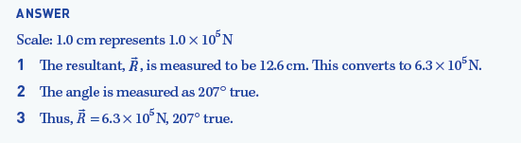
Worked example 1.2.2 (cont’d)
Notes:
Teaching activity:
As a class, work through the example provided

Slide 12
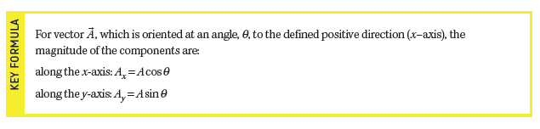
Key formula
Notes:
Teaching activity:
Read and discuss the key formula

Slide 13
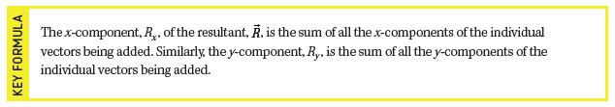
Key formula
Notes:
Teaching activity:
Read and discuss the key formula

Slide 14
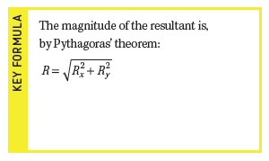
Key formula
Notes:
Teaching activity:
Read and discuss the key formula

Slide 15
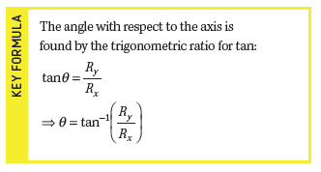
Key formula
Notes:
Teaching activity:
Read and discuss the key formula

Slide 16
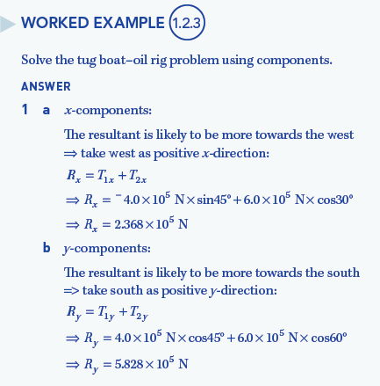
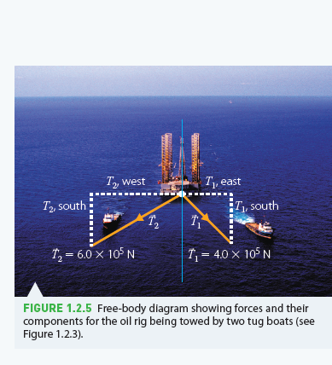
Worked example 1.2.3
Notes:
Teaching activity:
As a class, work through the example provided

Slide 17
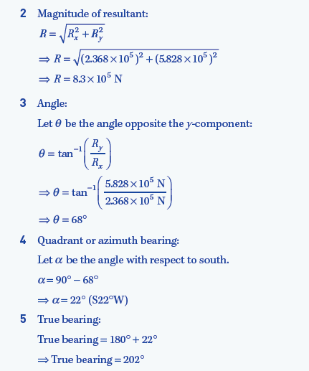
Worked example 1.2.3 (cont’d)
Notes:
Teaching activity:
As a class, work through the example provided

Slide 18
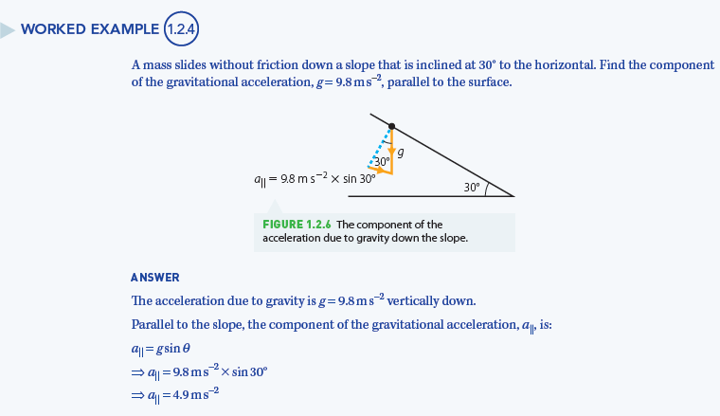
Worked example 1.2.4
Notes:
Teaching activity:
As a class, work through the example provided

