Slide 1
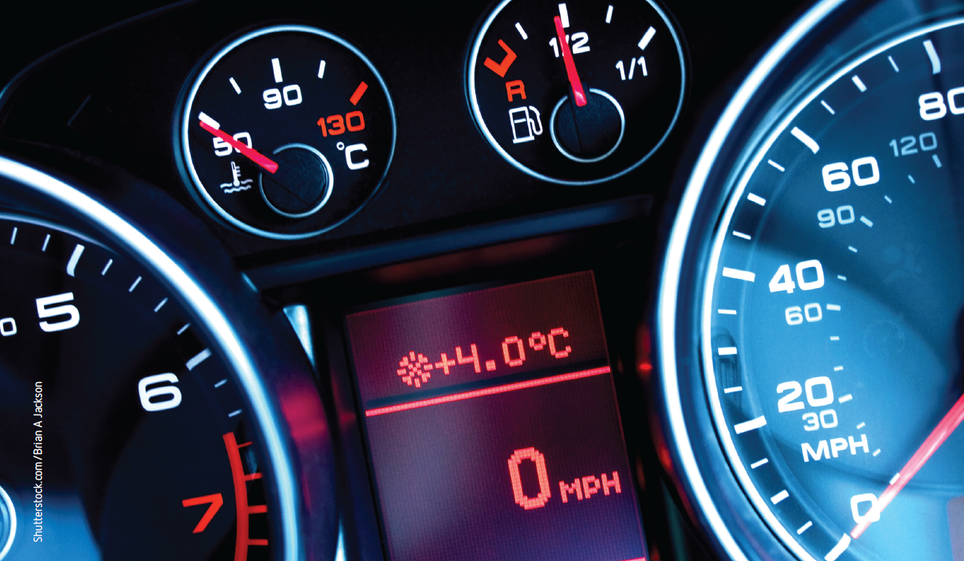
Chapter 1: Kinetic particle model and heat flow
Notes:
Image description: Close up of car dashboard on sports car

Slide 2
Stimulus questions
What is heat?
What is the difference between heat and temperature?
What effect does the addition of heat or a change in temperature have on a substance?
What happens to objects as their temperature approaches absolute zero?
Notes:
Teaching activity:
Before beginning the chapter, divide the students into small groups and ask them to answer the questions to the best of their ability.
After completing the chapter, read through each of the stimulus questions with the students. As a class answer each of the questions.
Asks the students to review the answers that they wrote before completing the chapter to the final answers.

Slide 3
1.1 Kinetic particle model of matter
Key terms
Matter | Plasma | Kinetic particle model | Atomic model | Brownian motion
Molecule | Derive | Kinetic energy | Elastic collision | Potential energy
Ideal gas | Temperature | Intermolecular forces | Elastic potential energy | Planck radiation curve
Boson
Notes:
Teaching activity:
Each of the key terms for 1.1, is listed in the table above.
Ask the students to copy the table and complete a definition for each term.

Slide 4
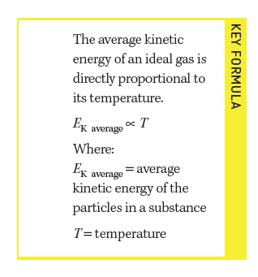
Key formula
Notes:
Teaching activity:
Read and discuss the key formula

Slide 5
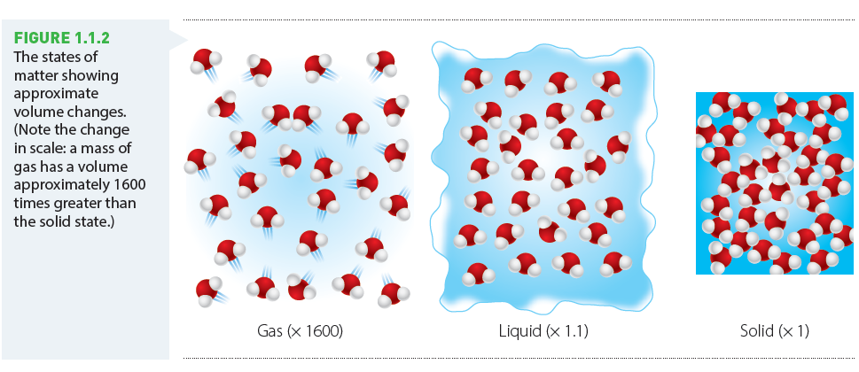
Key concept
Notes:
Teaching activity:
As a class, discuss the diagram.
Ask the students to create their own version

Slide 6
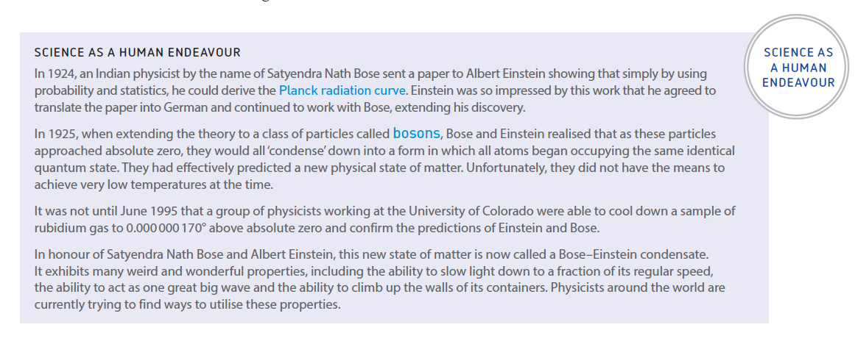
Science as a Human Endeavour (SHE)
Notes:
Teaching activity:
As a class read the science as a human endeavor.
Discuss how Bose and Einstein’s work has contributed to our current understanding of the states of matter.
Choose one of the properties described and conduct further research.

Slide 7
1.2 The energy model
Key terms
Joule | Internal energy | The first law of thermodynamics | Phase change | Boltzman distribution
Heat | Thermal energy
Notes:
Teaching activity:
Each of the key terms for 1.1, is listed in the table above.
Ask the students to copy the table and complete a definition for each term.

Slide 8
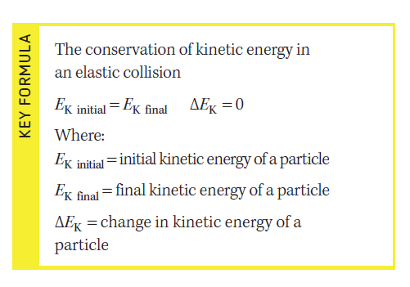
Key formula
Notes:
Teaching activity:
Read and discuss the key formula

Slide 9
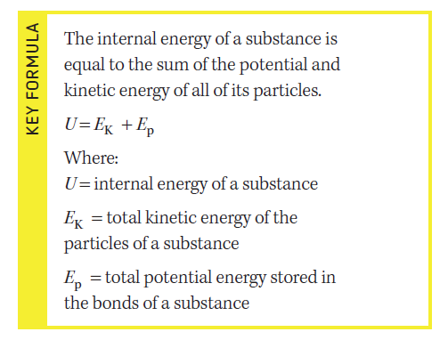
Key formula
Notes:
Teaching activity:
Read and discuss the key formula

Slide 10
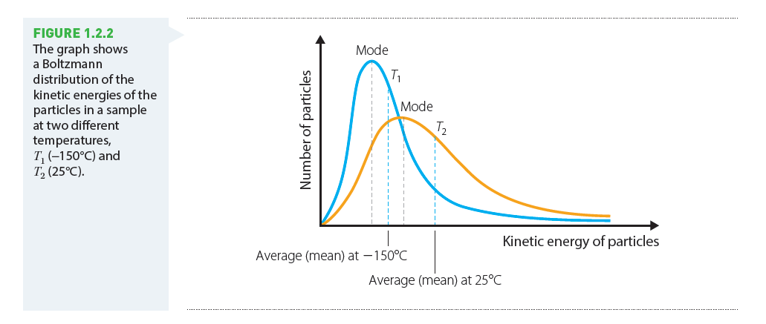
Key concept
Notes:
Teaching activity:
As a class, discuss the diagram.
Ask the students to create their own version

Slide 11
1.3 Heat transfers
Key terms
Anthropoengic | Conduction | Thermal conductivity | Heat conductor | Heat insulator
Delocalised valence electrons | Convection | Convection current | Convection cell | Thermal currents
Radiation
Notes:
Teaching activity:
Each of the key terms for 1.1, is listed in the table above.
Ask the students to copy the table and complete a definition for each term.

Slide 12
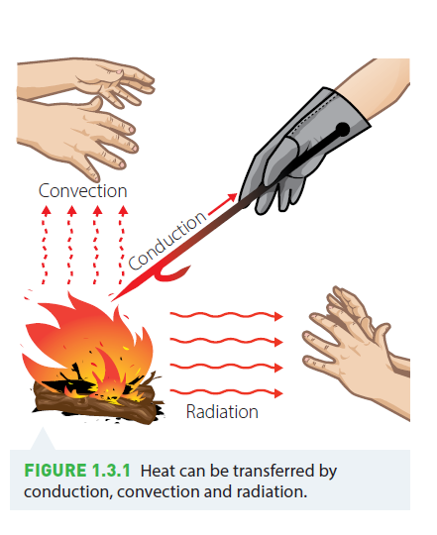
Key concept
Notes:
Teaching activity:
As a class, discuss the diagram.
Ask the students to write a paragraph that explains the process of heat transfer

Slide 13
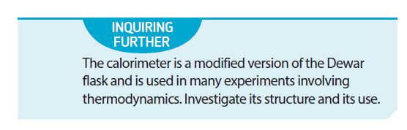
Inquiring further
Notes:
Teaching activity:
Read the inquiring further activity as a class.
Ask the students, in small groups, to complete the research task.
Students can present their findings as a research report or a multi-modal presentation.

