Slide 1
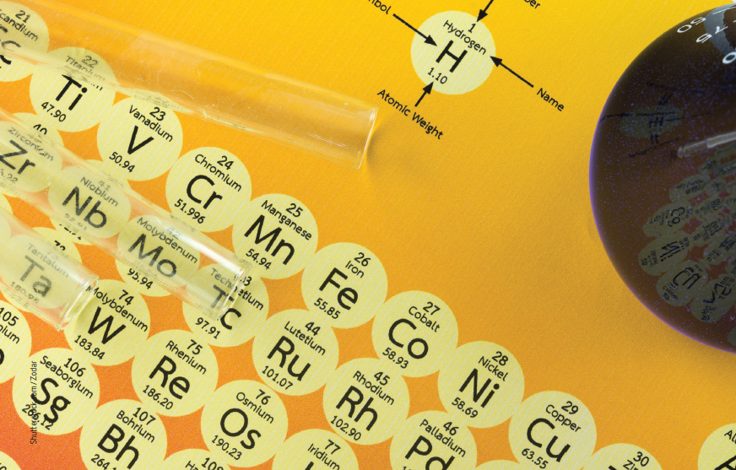
Chapter 1: The periodic table and trends
Notes:
Image description: Laboratory glassware and periodic table of elements

Slide 2
Stimulus questions
Why was Dmitri Mendeleev’s work such an important breakthrough?
How does the periodic table help us to compare and explain the properties of elements?
Notes:
Teaching activity:
Before beginning the chapter, divide the students into small groups and ask them to answer the questions to the best of their ability.
After completing the chapter, read through each of the stimulus questions with the students. As a class answer each of the questions.
Asks the students to review the answers that they wrote before completing the chapter to the final answers.

Slide 3
1.1 The periodic table of elements
Key terms
element | IUPAC | periodic table of elements | period | group
atomic number
Notes:
Teaching activity:
Each of the key terms for 1.1, is listed in the table above.
Ask the students to copy the table and complete a definition for each term.

Slide 4
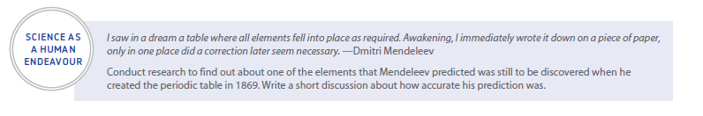
Science as a human endeavour
Notes:
Teaching activity:
As a class read the science as a human endeavour.
Discuss the quote by Mendeleev.

Slide 5
1.2 Trends in the periodic table
Key terms
atomic radius | nucleus | electron shells | valence shell | valency
ionic radius | first ionisation energy | ion | successive ionisation energies | electronegativity
Notes:
Teaching activity:
Each of the key terms for 1.2, is listed in the table above.
Ask the students to copy the table and complete a definition for each term.

Slide 6
1.3 Metallic and non-metallic character in the periodic table
Key terms
malleability | ductility | sublimation
Notes:
Teaching activity:
Each of the key terms for 1.3, is listed in the table above.
Ask the students to copy the table and complete a definition for each term.

Slide 7
1.4 Properties of the oxides of the elements in period 3
Key terms
oxide | giant covalent network | covalent bond | molecule | intermolecular forces
alkali | pH | neutralisation | amphoteric substance | acid
Notes:
Teaching activity:
Each of the key terms for 1.3, is listed in the table above.
Ask the students to copy the table and complete a definition for each term.

