Slide 1
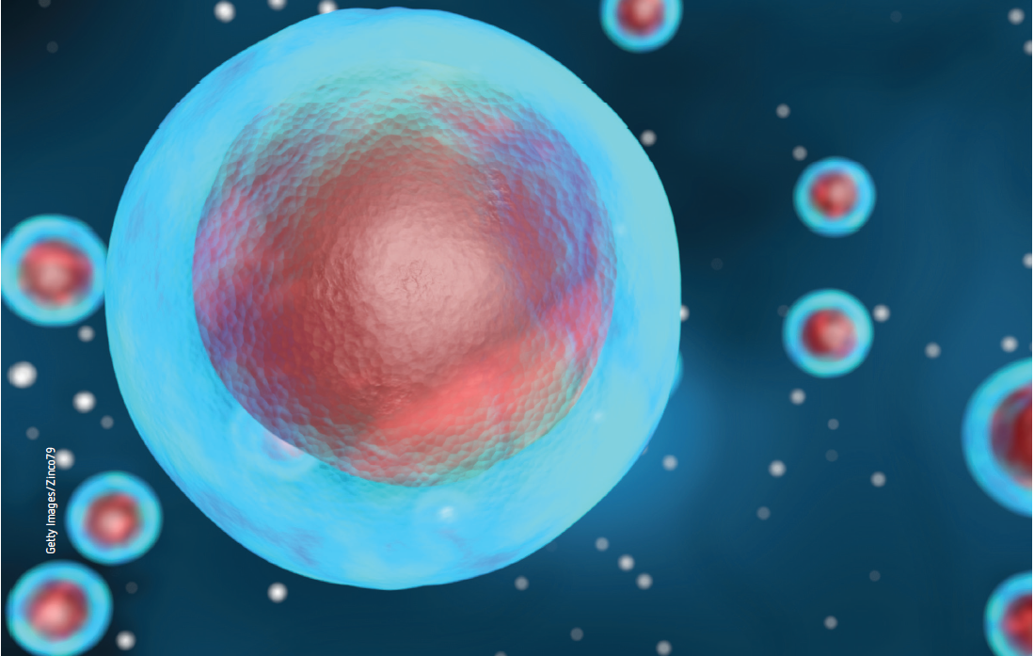
Chapter 1: Cell membranes

Slide 2
Stimulus questions
How do cells obtain their requirements and remove their wastes?
In a large complex organism, how do individual cells recognise each other?
Why are there no unicellular organisms?
Why is it that cells divide rather than continuing to increase in size?
Notes:
Teaching activity:
Read through each of the stimulus questions with the students. Ask the students, either individually or in small groups, to write an answer to each question.
After completing the chapter, read through each of the stimulus questions with the students. Ask the students, either individually or in small groups, to write an answer to each question.
Ask the students to compare their answers at the start of the chapter to their final answers.

Slide 3
1.1 Structure of the cell membrane
Key terms
cell membrane | differentially permeable | external environment | fluid mosaic phospholipid bilayer model | bilayer
internal environment | phospholipid | hydrophilic | hydrophobic | cytoplasm
cholesterol | phytosterol | vesicle | channel protein | protein channel
Notes:
Teaching activity:
Each of the key terms for 1.1 is listed in the table above.
Ask the students to copy the table and complete a definition for each term.

Slide 4
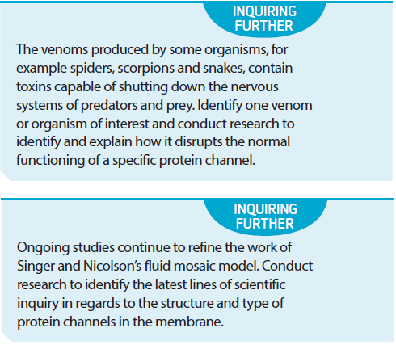
Inquiring further
Notes:
Teaching activity:
Read the inquiring further activity as a class.
Ask the students, in small groups, to complete the research task.
Students can present their findings as a research report or a multi-modal presentation.

Slide 5
Inquiring further
Notes:
Teaching activity:
Read the inquiring further activity with the students.
Ask the students to:
Define the fluid mosaic model,
Create a research plan to identify new research into the fluid mosaic model,
Conduct the research based on the plan,
Present the research as a research report.

Slide 6
1.2 Passive movement
Key terms
passive transport | diffusion | concentration gradient | equilibrium | facilitated equilibrium
carrier protein | osmosis | solvent | solute | solution
isotonic | hypotonic | hypertonic | permeable | turgid
wilting | flaccid | plasmolysis | contractile vacuole
Notes:
Teaching activity:
Each of the key terms for 1.2 is listed in the table above.
Ask the students to copy the table and complete a definition for each term.

Slide 7
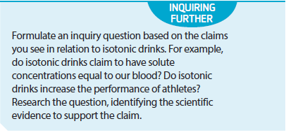
Inquiring further
Notes:
Teaching activity:
As a class, read the inquiring further.
As a class, discuss the claims that are made in relation to isotonic drinks.
As a class, formulate a research question based on the inquiring further activity.

Slide 8
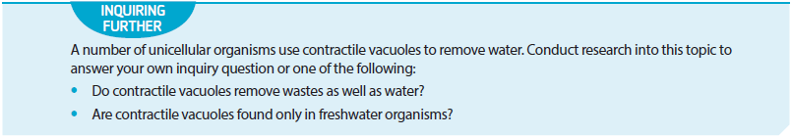
Inquiring further
Notes:
Teaching activity:
As a class read the inquiring further question.
Working in small groups ask the students to choose one of the two options and develop an inquiry question.

Slide 9
1.3 Active transport
Key terms
active transport | adenosine triphosphate (ATP) | sodium-potassium pump
Notes:
Teaching activity:
Each of the key terms for 1.3 is listed in the table above.
Ask the students to copy the table and complete a definition for each term.

Slide 10
1.4 Movement of large molecules
Key terms
polar | endocytosis | phagocytosis | exocytosis
Notes:
Teaching activity:
Each of the key terms for 1.4 is listed in the table above.
Ask the students to copy the table and complete a definition for each term.

Slide 11
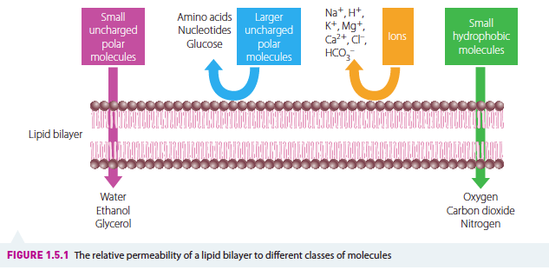
1.5 Direction of movement
Notes:
Teaching activity:
As a class, discuss the diagram.

Slide 12
1.6 Size of cells
Key terms
surface-area-to-volume ratio | cytoplasmic streaming
Notes:
Teaching activity:
Each of the key terms for 1.6 is listed in the table above.
Ask the students to copy the table and complete a definition for each term.

Slide 13
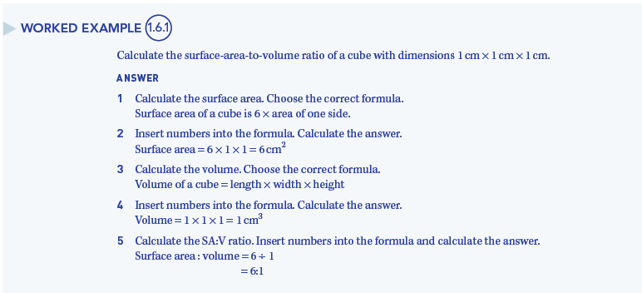
Worked example
Notes:
Teaching activity:
Read through the worked example with the students.
Working in pairs, ask the students to explain the worked example to each other.

