Slide 1
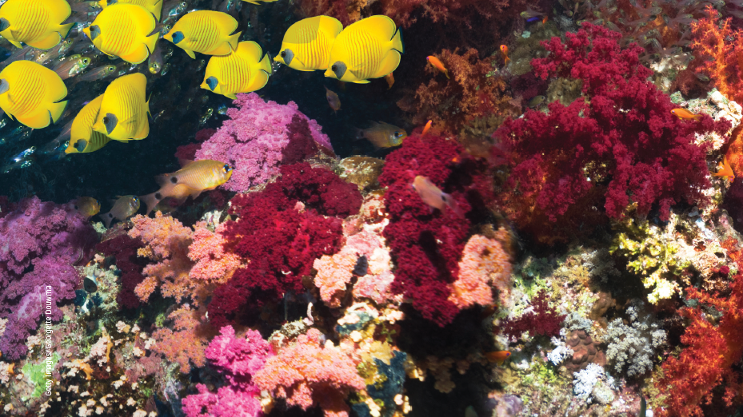
Chapter 1: Cell membranes
Notes:
Teaching activity:
Use a think aloud strategy to engage students with the topic and to pre-test the students’ knowledge of biodiversity. Working in pairs, the students brainstorm as many words and ideas as they can about Earth, Australia and biodiversity.
After listing as many words as they can, the students ask each other questions and talk about the words they chose. For example: if a student writes down ‘Australia is a biodiverse continent’, they may be asked ‘why do you think that?’; ‘what is the evidence for that statement?’; ‘what is meant by biodiversity?’; ‘do you know a country that isn’t very diverse?’

Slide 2
Stimulus questions
How do you measure biodiversity?
How do environmental factors affect biodiversity?
How do are ecosystems defined and compared?
Notes:
Teaching activity:
Read through each of the stimulus questions with the students. Ask the students, either individually or in small groups, to write an answer to each question.
After completing the chapter, read through each of the stimulus questions with the students. Ask the students, either individually or in small groups, to write an answer to each question.
Ask the students to compare their answers at the start of the chapter to their final answers.

Slide 3
1.1 The diversity of species and ecosystems
Key terms
biodiversity | ecosystem | species | biotic factors | abiotic factors
photosynthesis | food web
Notes:
Teaching activity:
Each of the key terms for 1.1 is listed in the table above.
Ask the students to copy the table and complete a definition for each term.

Slide 4
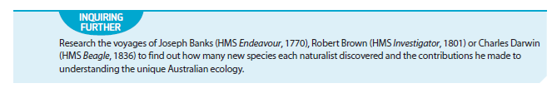
Inquiring further
Notes:
Teaching activity:
Before beginning their research, encourage the students to list all of the information that they currenly know about their chosen person in a PMI chart.
Ask the students to compare what they thought they knew to what they learnt in the research.
Ask the students to anlayse and evaluate any misconceptions that they may have had.

Slide 5
1.2 Determining the diversity of species
Key terms
species richness | relative species abundance | percentage cover | percentage frequency | Simpson’s diversity index
quadrat
Notes:
Teaching activity:
Each of the key terms for 1.2 is listed in the table above.
Ask the students to copy the table and complete a definition for each term.

Slide 6
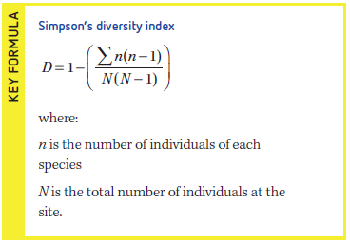
Key formula

Slide 7
1.3 Comparing ecosystems
Key terms
spatial scale | macro-level ecosystem | meso-level ecosystem | micro-level ecosystem | predation
competition | producer | consumer | temporal scale | diurnal
niche
Notes:
Teaching activity:
Each of the key terms for 1.3 is listed in the table above.
Ask the students to copy the table and complete a definition for each term.

Slide 8
1.4 Environmental limiting factors
Key term
limiting factor
Notes:
Teaching activity:
Ask the students to complete a definition for the key term.

Slide 9
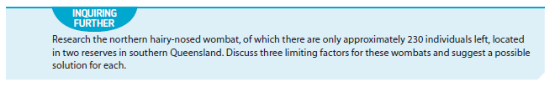
Inquiring further
Notes:
Teaching activity:
As a class read through the inquiring further activity.
Working individually, or in pairs, the students create and complete a research organiser based on the question in the activity.
Present the findings in a short research report.
Extension: Read a copy of The Hairy Nosed Wombats Find a New Home by Jackie French, published by Harper Collins, 2014.
Using the research from the inquiring further activity, analyse the text and determine the accuracy of the information it contains.

