Slide 1








Slide 2
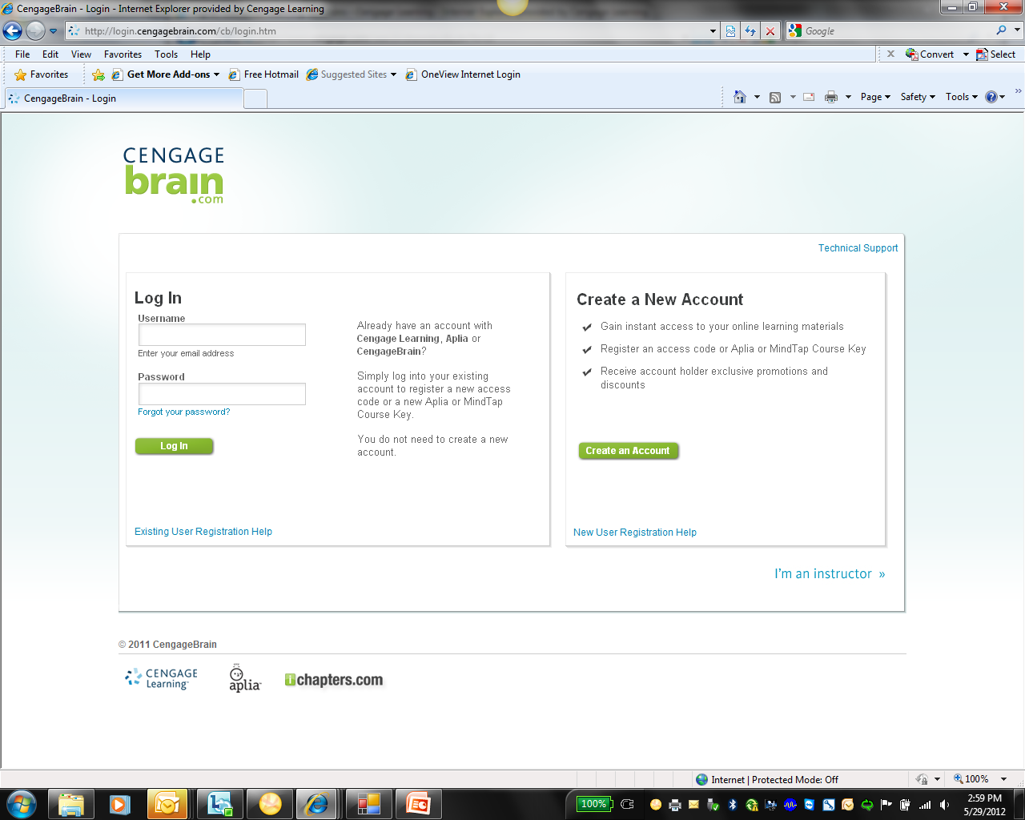
Signing in to Aplia
Go to login.cengagebrain.com
Click “Create an Account”
(After first time, use “Log In”)

Slide 3
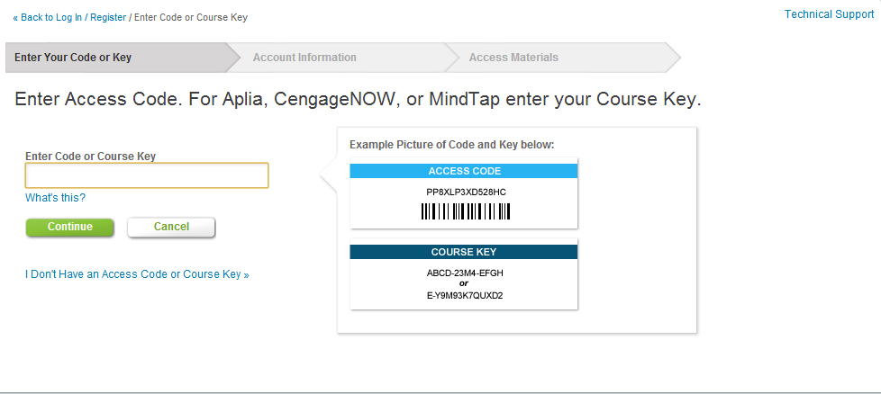
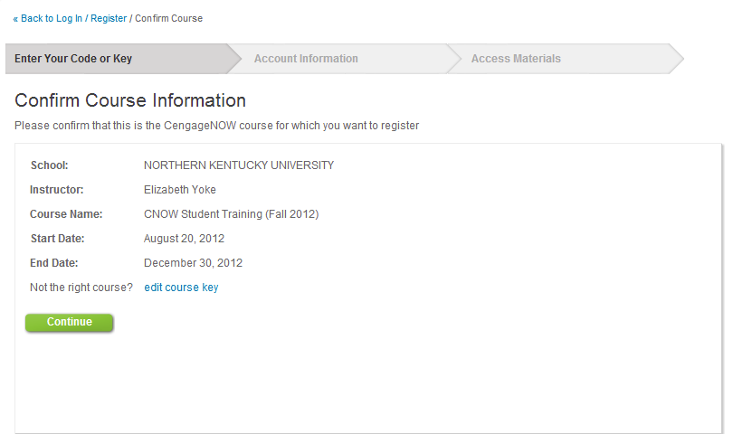
Signing in to Aplia
Step 1: Enter Aplia Course Key and select continue.
Step 2:
Confirm this is the Aplia course to which you would like to register. If the course is incorrect, click Edit Course Key. If correct, click Continue.
Notes:
Course Key : ZCKZ-JXR5-ZAAV

Slide 4
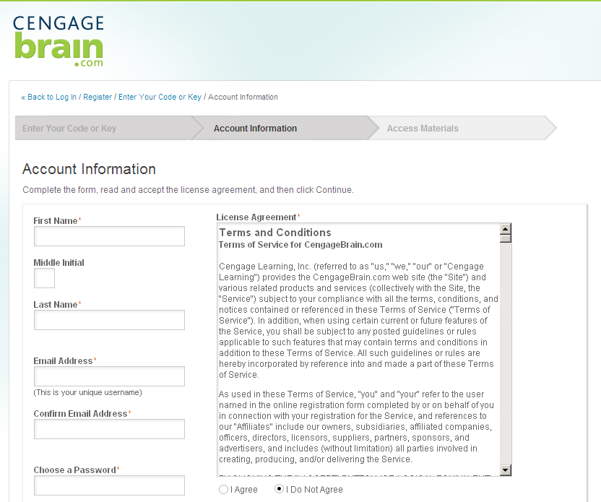
Signing in to Aplia
Step 3:Fill out account information and click “I agree” to License Agreement

Slide 5
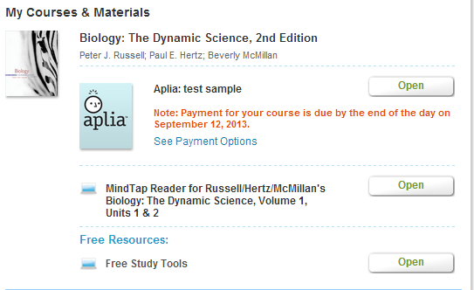
Signing in to Aplia
Step 4: Click “Open”
to access
Aplia

Slide 6
Signing in to Aplia
Step 5:
You will have until the end of the grace period to pay for your Aplia course. Click See Payment Options.

Slide 7
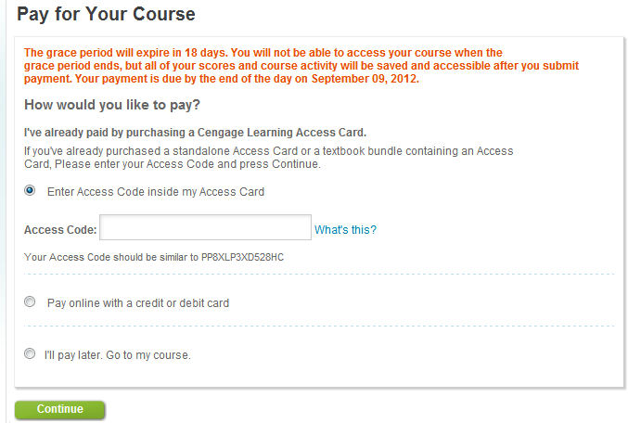
Signing in to Aplia
If you have purchased an Access Code, enter the access code into the field provided. You can also purchase instant access online using a credit or debit card. You can choose to pay later, but you must pay for your Aplia course before the end of the grace period.
Notes:
Access Code: PP3V45SP34D1V0

Slide 8
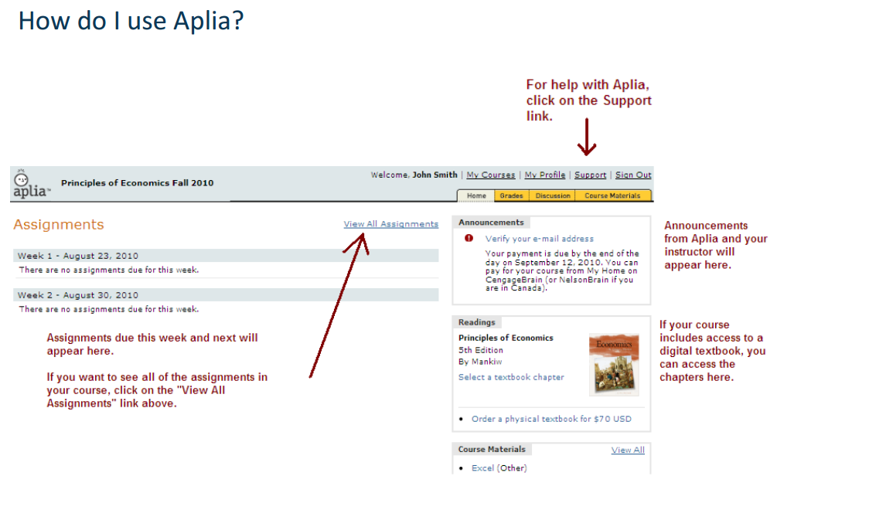
Aplia Homepage
Notes:
Just walk the student through the various components highlighted in red here.

Slide 9
Need Assistance?
Questions about your CengageBrain account?
Check the FAQS in the support section of CengageBrain
Send an email to cengagebrain.support@cengage.com
Call 1-866-994-2427 Monday through Friday from 8 AM to 6 PM EST
Do you need technical support?
Go to www.cengage.com/support for 24/7 live chat!
Call 1-800-354-9706 Monday through Thursday 8:30AM to 9:00PM EST and Friday 8:30AM to 6:00PM EST
Notes:
If you have questions about your CengageBrain account or need technical support please refer to the information provided here.

